Slide 1
S J C INSTITUTE OF TECHNOLOGY
DEPARTMENT OF COMPUTER SCIENCE AND ENGINEERING
PROJECT ON
“Medical Confidentiality And Data Privacy Preserving Using Homomorphism”
BY
Y.Pranay Kumar Redddy
1SJ20CS173
Under the Guidance of H Srinivas Murthy Associate Professor CSE,SJCIT
Coordinators
Dr. Seshaiah M , Dr. Shrihari M R
Associate Professors CSE,SJCIT
Head of the Department Dr. Manjunatha kumar B H Professor
CSE,SJCIT

Slide 2
CONTENTS
ABSTRACT
INTRODUCTION
LITERATURE SURVEY
PROBLEM IDENTIFICATION & DEFINITION
SIGNIFICANCE & RELEVANCE OF WORK
OBJECTIVES AND METHODOLOGY
SYSTEM REQURIMENTS & SPECIFICATIONS
ANALYSIS
DESIGN
IMPLEMENTATION
TESTING
RESULTS AND DISCUSION
CONCLUSION AND FUTURE ENHANCEMENTS
BIBLIOGRAPHY
Dept. of CSE, SJCIT

Slide 3
ABSTRACT
Increasingly, hospitals and research institutes are developing technical solutions for sharing patient data in a privacy preserving manner. Two of these technical solutions are homomorphic encryption and distributed ledger technology. Homomorphic encryption allows computations to be performed on data without this data ever being decrypted. Therefore, homomorphic encryption represents a potential solution for conducting feasibility studies on cohorts of sensitive patient data stored in distributed locations. Distributed ledger technology provides a permanent record on all transfers and processing of patient data, allowing data custodians to audit access. A significant portion of the current literature has examined how these technologies might comply with data protection and research ethics frameworks.

Slide 4
INTRODUCTION
Data concerning health means personal data related to the physical or mental health of persons, including the provision of healthcare, which reveal information about a persons’ health.
The General Data Protection Regulation determines that certain types of data fall under a special category of personal data. This includes ‘data concerning health’ This special category of personal data is also referred to as ‘sensitive data’, because these types of data require additional protection as they can go to the very core of a human being. Health data comes within a person’s most intimate sphere

Slide 5
SMSs provide various features such as tracking real-time or near-real-time usage data detection of abnormal usage more accurate billing information and the ability to share the collected fine-grained data with third-party analysts for more comprehensive analysis
This raises serious privacy concerns, as malicious actors, including service providers,
third-party analysts, or neighbors, can eavesdrop and analyze these data without user consent.
The critical role of data privacy in healthcare and the limitations of traditional encryption methods. The concept of homomorphic encryption and its revolutionary potential for secure data analysis. The anticipated benefits of HE in the medical field, including enhanced patient privacy, facilitated collaboration, and improved data security.

Slide 6
LITERATURE SURVEY
Sl . N o | Paper Name | Methodology | Remarks
1 | A more efficient leveled strongly un forgeable fully homomorphic signature scheme | Authors propose a new leveled fully homomorphic signature scheme, which only needs to call the signing algorithm twice for generating signatures for all messages in a dataset. | This is a significant improvement in efficiency over the previous HS schemes that need to call the signing algorithm for polynomial times. But failed to preserve improved efficiency
2 | Adaptively Secure Fully Homomorphic Signatures Based on Lattices | In this paper, authors construct the first adaptively secure homomorphic signature scheme that can evaluate any circuit over signed data. | but unlike complexity leveraging, the security loss in this approach reduction depends on circuit depth
3 | Leveled Adaptively Strong-Unforgeable Identity-Based Fully Homomorphic Signatures | In this work, Authors construct the first leveled adaptively secure identity- based fully homomorphic signature (IBFHS) schemes without additional public parameters, which can be used to sign many different datasets | the complexity of verifying a signature for a computation is very high.
Dept. of CSE, SJCIT
6

Slide 7
Sl. No | Paper Name | Methodology | Remarks
4 | Implementation of Cyber Security for Enabling Data Protection Analysis and Data Protection using Robot Key Homomorphic Encryption | This research work has proposed a Role Key Homomorphic Encryption Algorithm (RKHEA) to monitor the cloud users, who access the services continuously | This method provides access creation of session- based keys which is vulnerable.
5 | A New LWE-based Homomorphic Encryption Algorithm over Intege | In this paper, they design a new homomorphic encryption algorithm based on LWE problem. The proposed algorithm can carry out multi-level homomorphism additions. | algorithm efficiency need to be improved as this approach failed to prove the correctness in the computation.
6 | An Encryption Depth Optimization Scheme for Fully Homomorphic Encryption | Authors propose a re-encryption optimization scheme, which designs a depth threshold value and do function decomposition while the depth value of given function is deeper than the designed depth threshold value | Based on analysis results, the complexity of the proposed scheme is high.
Dept. of CSE, SJCIT

Slide 8
PROBLEM IDENTIFICATION & DEFINITION
PROBLEM IDENTIFICATION
Homomorphic encryption is a cryptographic technique that allows computations to be performed on
encrypted data without decrypting it.
This is particularly useful in scenarios where sensitive data needs to be processed or analyzed by a third party while keeping it confidentia
The advanced analytics and machine learning algorithms can be applied to encrypted medical data without compromising individual privacy.
PROBLEM DEFINITION:
Homomorphic encryption has significant potential applications in the healthcare sector, where the privacy
and security of sensitive medical data are of utmost importance.

Slide 9
SIGNIFICANCE & RELEVANCE OF WORK
In healthcare systems for data privacy cannot be overstated, as it addresses critical challenges at the intersection of technology, privacy, and healthcare delivery. With the exponential growth of digital health data, protecting patient privacy has become a paramount concern, especially given the increasingly sophisticated threats posed by cyberattacks and data breaches. By leveraging homomorphic encryption, healthcare organizations can perform computations on encrypted data without the need for decryption, thus preserving the confidentiality of sensitive information while enabling secure data processing and analysis. This groundbreaking approach not only mitigates the risk of unauthorized access to patient records but also facilitates secure data sharing among healthcare providers, researchers, and other stakeholders. Furthermore, in an era marked by growing regulatory scrutiny and heightened public awareness of data privacy issues, the adoption of homomorphic encryption demonstrates a commitment to upholding the highest standards of data protection and compliance with regulations such as (HIPPA)Health Insurance Portability and Accountability Act.

Slide 10
OBJECTIVES & METHODOLOGY
Homomorphic encryption has significant potential applications in the healthcare sector, security of sensitive where the privacy and medical data are of utmost importance.
Homomorphic encryption enables the execution of computations on encrypted patient data by preserving patient privacy.
The advanced analytics and machine learning algorithms can be applied to encrypted medical data without compromising individual privacy.
This is particularly relevant for developing predictive models and extracting insights from large datasets while ensuring compliance with data protection regulations.

Slide 11
METHODOLOGY
Client (Patient or Doctor) sends data to third party service provider for performing a query/operation. Before sending, client encrypts the data.
The client then asks the cloud service provider to perform a certain function on the data and provide the results.
Cloud service provider then performs operations using homomorphic encryption property with diagnosis of a particular disease.
Encrypted results are provided to client
Client at its end computes decryption using decryption function and recovers message.

Slide 12
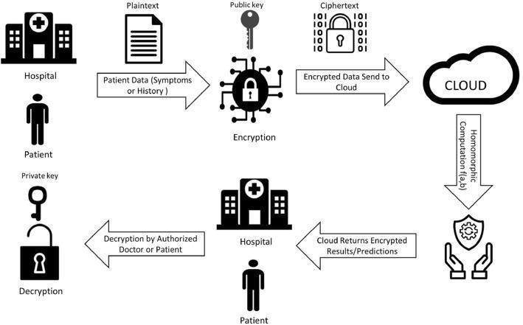
Fig:-Data Privacy Using Homomorphic Encryption

Slide 13
SYSTEM REQIREMENTS AND SPECIFICATION
Hard ware Requirements
Storage :24GB of Space.
Network Connectivity: The network connection can be wired or wireless GPU:4GB
Software Requirements
Operating System: windows 10 or 11
Secure Key Management
Data Encryption and Decryption Algorithms Secure Data Transmission
Compliance with Privacy Regulations

Slide 14
ANALYSIS
Homomorphic encryption is a cryptographic technique that allows computations to be
performed on encrypted data without decrypting it.
In other words, it enables computations on data while it is still in an encrypted state, preserving privacy and security.
This is particularly useful in scenarios where sensitive data needs to be processed or analyzed by a third party while keeping it confidential.
It enables the execution of computations on encrypted patient data by preserving patient privacy. The advanced analytics and machine learning algorithms can be applied to encrypted medical data without compromising individual privacy.

Slide 15
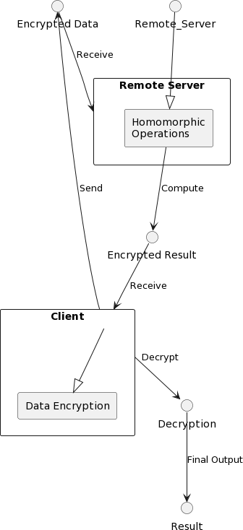
DESIGN
ARCHITECTURE DIAGRAM

Slide 16
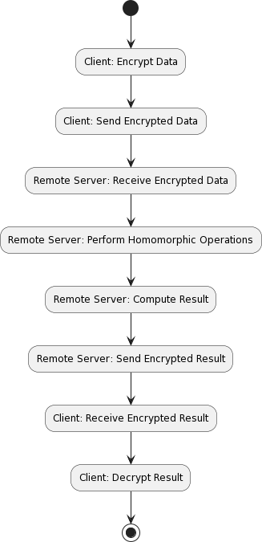
Data Flow Diagram

Slide 17
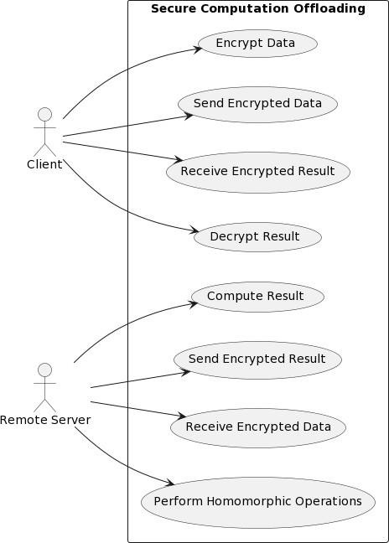
USE CASE DIAGRAM

Slide 18
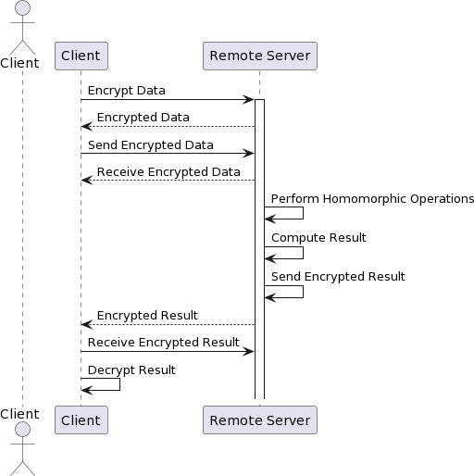
SEQUENCE DIAGRAM

Slide 19
IMPLEMENTATION
Modules split up &explanation of each module
Data Encryption Module:
This module is responsible for encrypting the data before it is sent to the remote server.
The data encryption module takes raw data as input and applies homomorphic encryption technique to
encrypt the data securely. It ensures that sensitive information remains confidential during transmission and processing on the remote server.
Communication Module:
This module handles the communication between the client and the remote server, including sending
and receiving encrypted data and results.
The communication module manages the exchange of encrypted data and results between the client and the remote server. It ensures reliable and secure communication channels are established, enabling data transmission and result retrieval.

Slide 20
Homomorphic Operations Module:
This module is responsible for performing homomorphic operations on the encrypted data.
The homomorphic operations module executes mathematical operations on the encrypted data
without decrypting it. It leverages homomorphic encryption schemes to perform computations on encrypted data while preserving its confidentiality.
Result Decryption Module:
This module decrypts the result received from the remote server.
The result decryption module decrypts the encrypted result received from the remote server using
the appropriate decryption key. It ensures that the final output is accessible in its original form to the client after secure computation offloading.

Slide 21
Authentication and Authorization Module:
This module handles authentication and authorization of clients and servers to ensure secure access to the system.
The authentication and authorization module verifies the identity of clients and servers before allowing access to the system.
It enforces access control policies to prevent unauthorized access and ensures that only authenticated users can initiate secure computation offloading.

Slide 22
ALGORITHM USED FOR EACH MODULES
Data Encryption Module:
Algorithm:
Input: Raw data
Output: Encrypteddata
Steps:
Generate encryption keys (public and private keys).
Encrypt the raw data using homomorphic encryption algorithms.
Output the encrypted data.

Slide 23
Communication Module:
Algorithm:
Input: Encrypted data or result
Output: Received encrypted data or result Steps:
Establish a secure communication channel between client and server.
Send encrypted data or result over the channel.
Receive encrypted data or result from the other party.

Slide 24
Homomorphic Operations Module:
Algorithm:
Input: Encrypted data
Output: Encrypted result Steps:
Perform homomorphic operations on the encrypted data.
Output the encrypted result.
Result Decryption Module:
Algorithm:
Input: Encrypted result
Output: Decrypted result Steps:
Decrypt the encrypted result using the private decryption key.
Output the decrypted result.

Slide 25
TESTING
Basic medical data: Test with numerical data like blood pressure, glucose levels, and medication dosages. Ensure accurate homomorphic addition, subtraction, multiplication, and division.
Large datasets: Simulate real-world scenarios with large patient cohorts. Evaluate scalability and performance impact on complex analyses.
Textual data: Explore homomorphic encryption for encrypted text search on medical reports or free-text diagnoses. Assess accuracy and efficiency.
Medical images: Investigate techniques for homomorphic encryption on medical images
(X-rays, MRIs) to enable privacy-preserving analysis like anomaly detection.

Slide 26
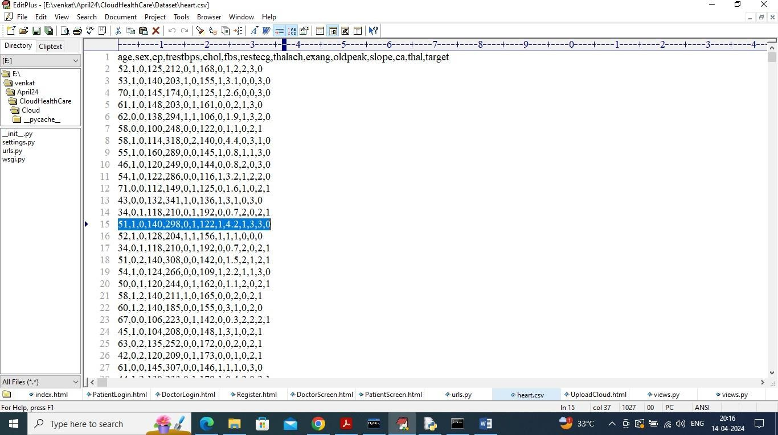
RESULTS AND DISCUSSION
In above dataset screen first row contains dataset column names all heart condition details and remaining rows contains values and in last column we have class labels as 0 (normal) and 1 (abnormal). In above screen all data is in plain format bit when patient upload any data then it will be encrypted.

Slide 27
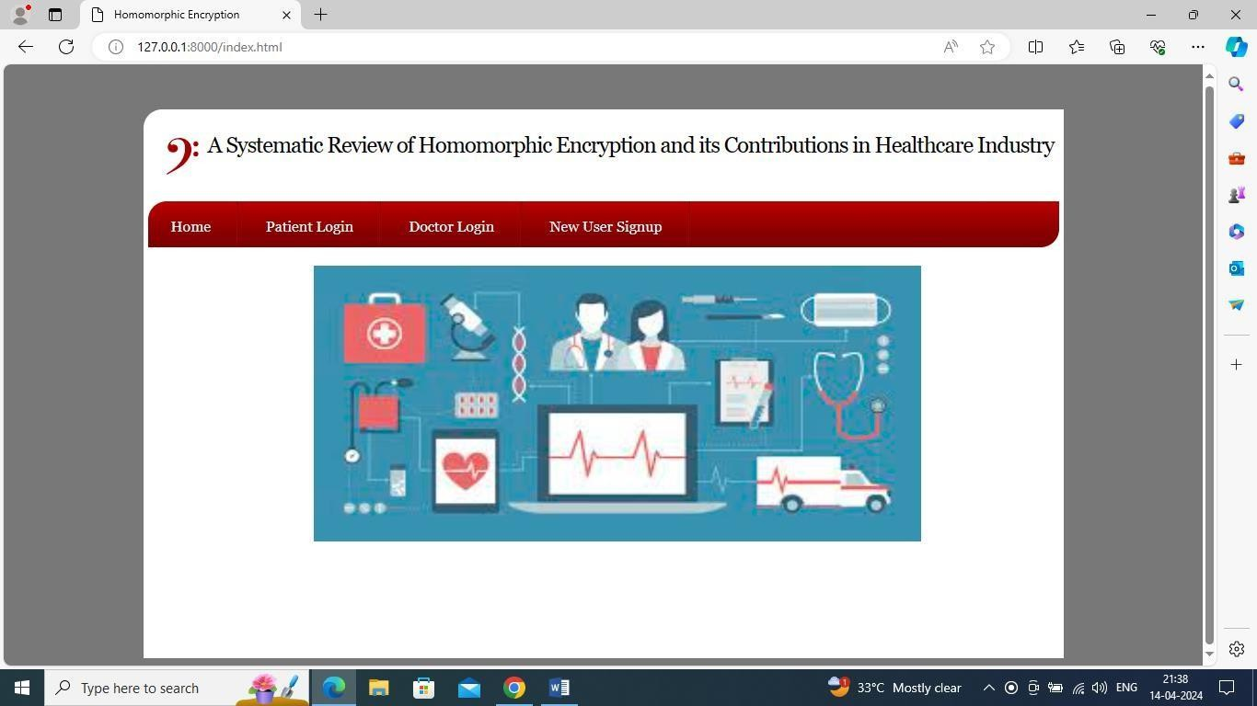
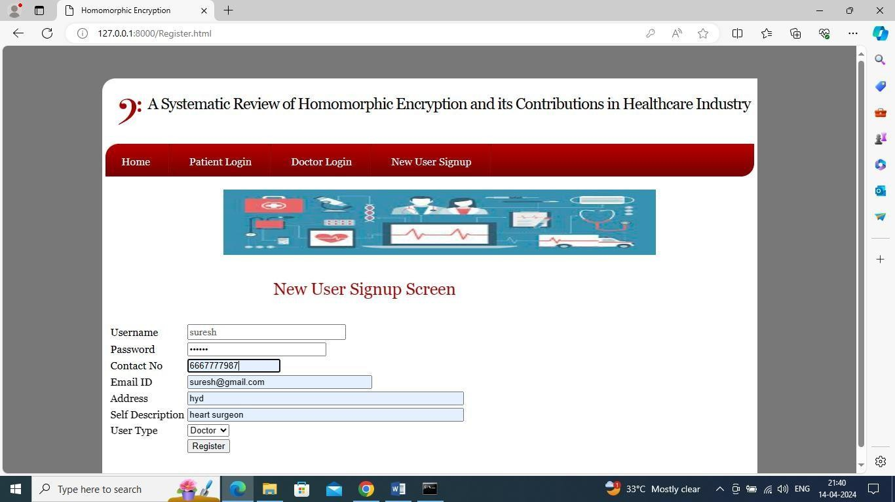
In above screen click on ‘New User Sign up’ link to register patients and doctors
In above screen adding doctor details and now click on ‘Register’ button to save doctor details in database

Slide 28
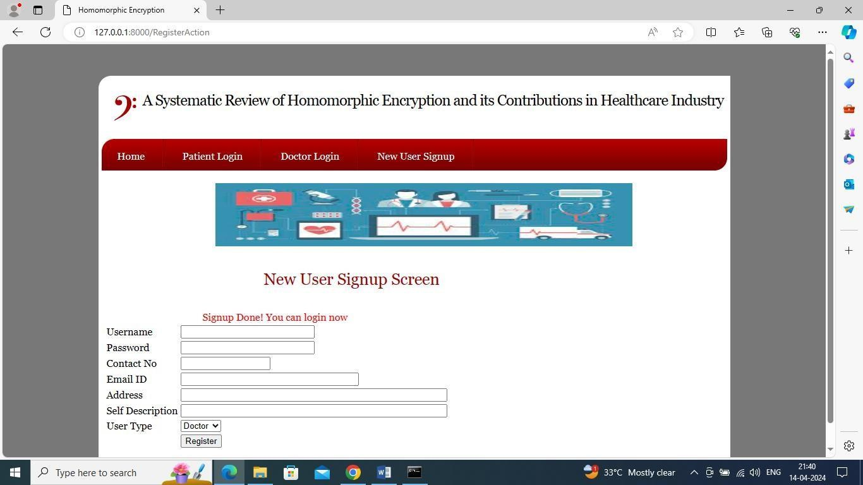
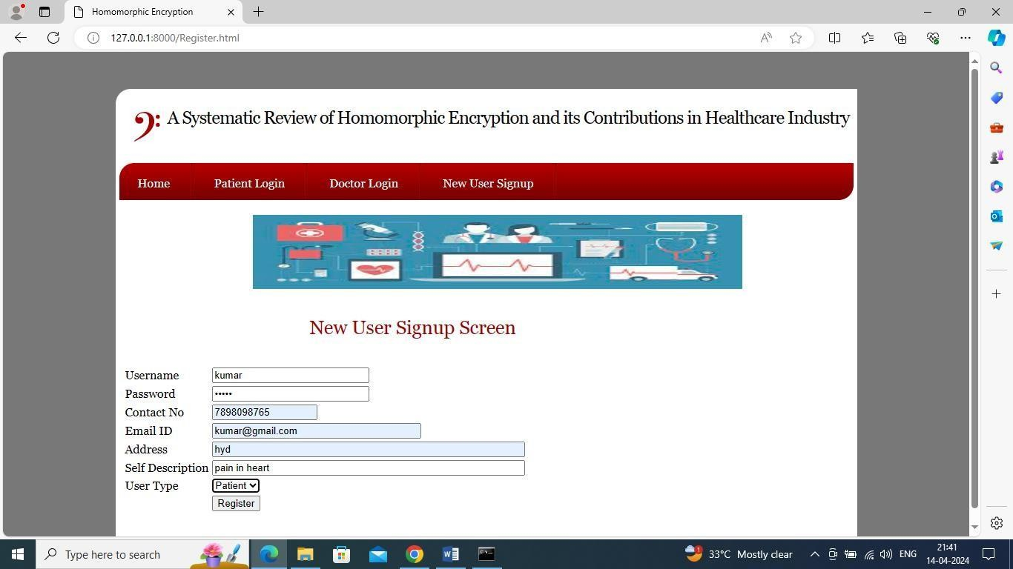
In above screen signup completed and now adding patients details
In above screen adding patient details and then press button to get below page

Slide 29

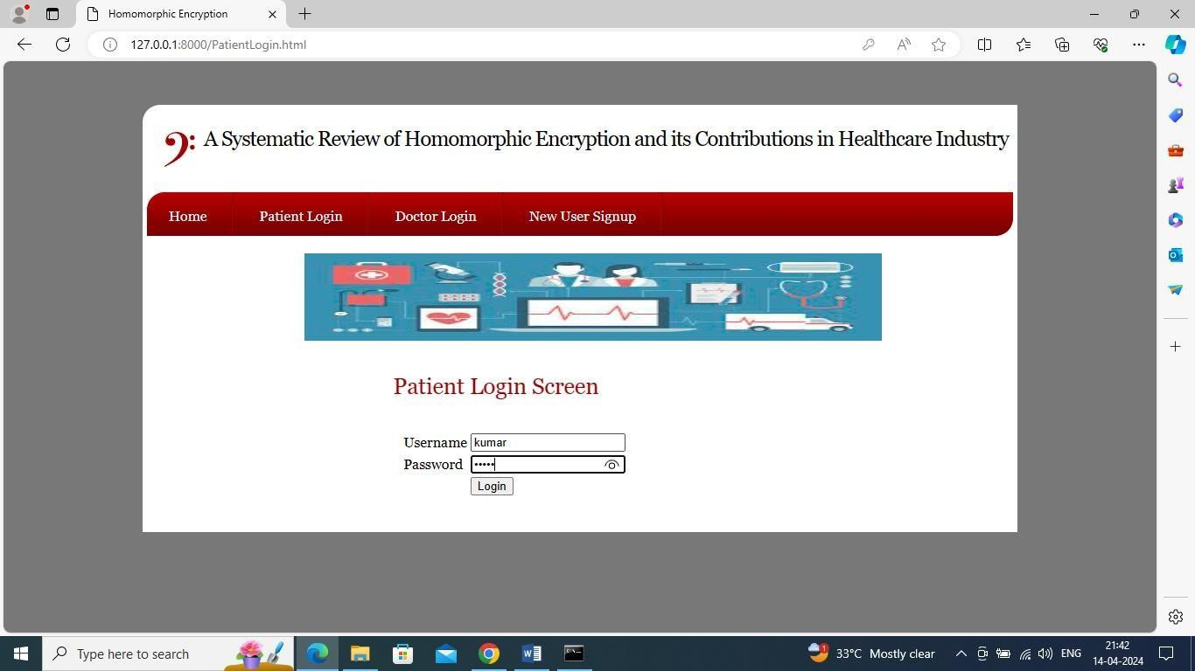
In above screen patient sign up completed and now click on ‘Patient Login’ link to get below page
In above screen login as patient and then click on
‘Login’ button to login as patient and get below page

Slide 30
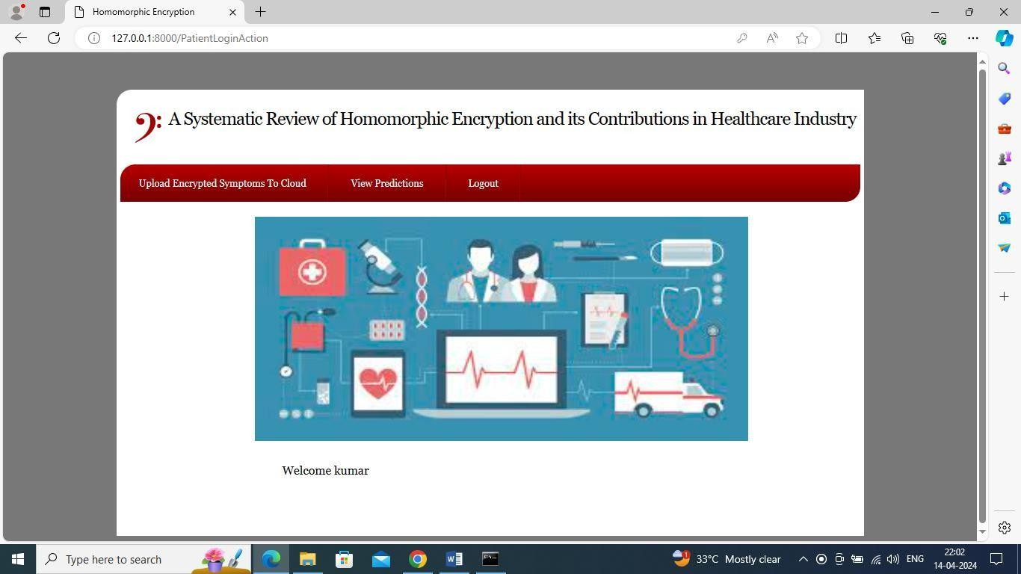
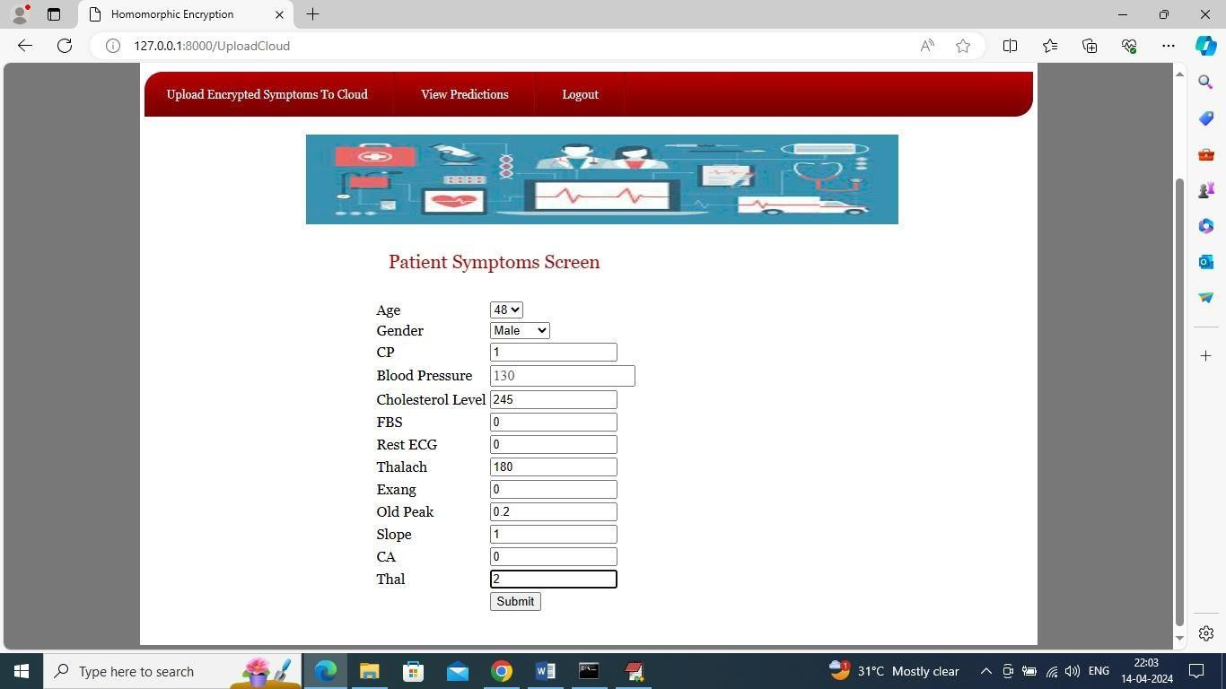
In above screen patient will enter all his heart symptoms and this symptoms you can take from Dataset/heart.csv file and then click on ‘Submit’ button to upload above details in cloud in encrypted format and get below predicted output
In above screen click on ‘Upload Encrypted Symptoms
to Cloud’ link to upload patient data

Slide 31
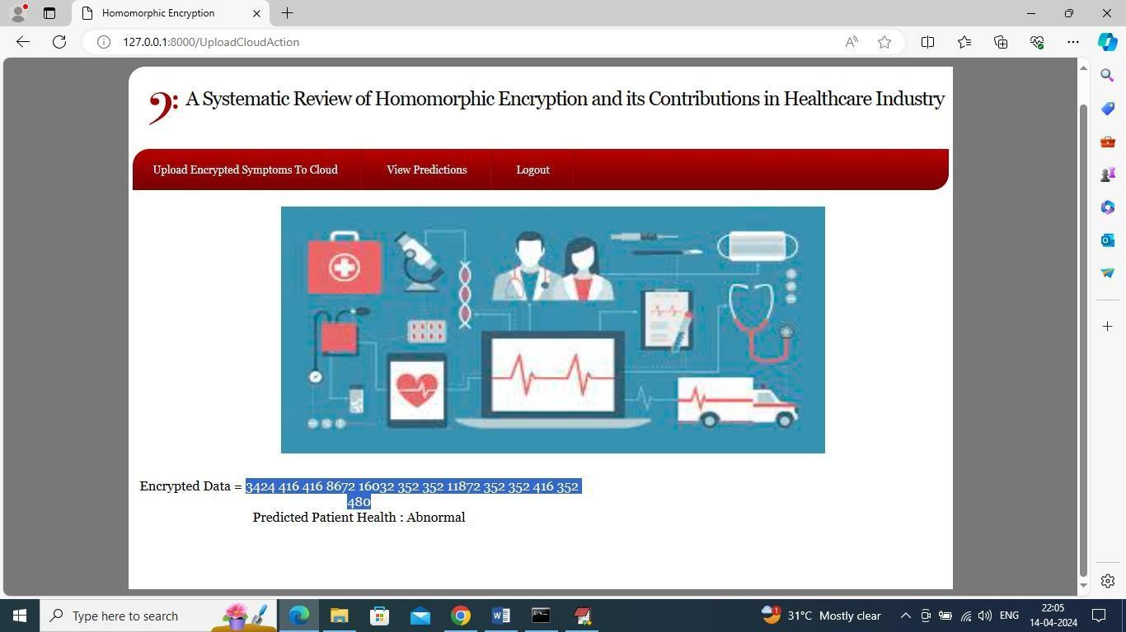
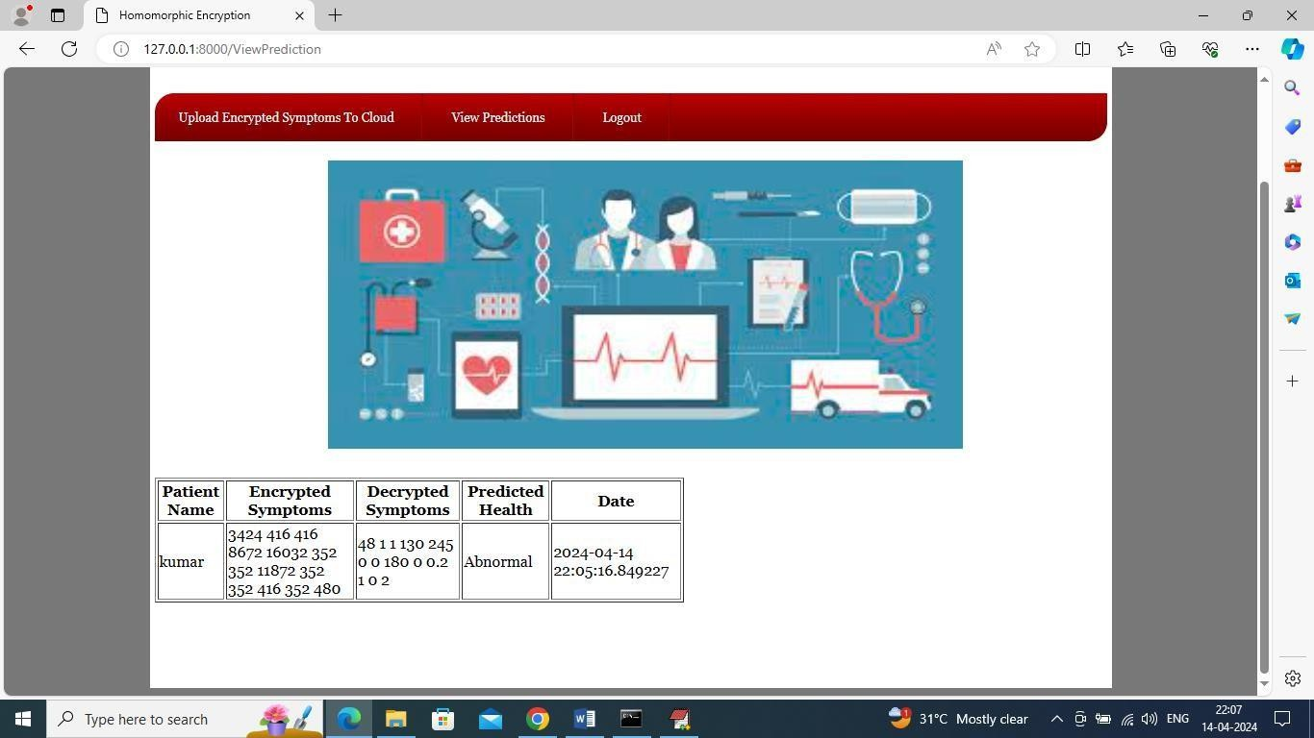
In above screen in blue colour text can see all patient heart data converted to encrypted format and then in next line can see predicted health condition as ‘Abnormal’ and similarly you can add details for any other patients and now click on ‘View Predictions’ link to view all past predictions for this patients
In above screen in first column patient can view his name and then can see encrypted heart details of patients and then can see Decrypted heart details and then can see predicted heart result with date and time. Now logout and login as doctor to view all patient details

Slide 32
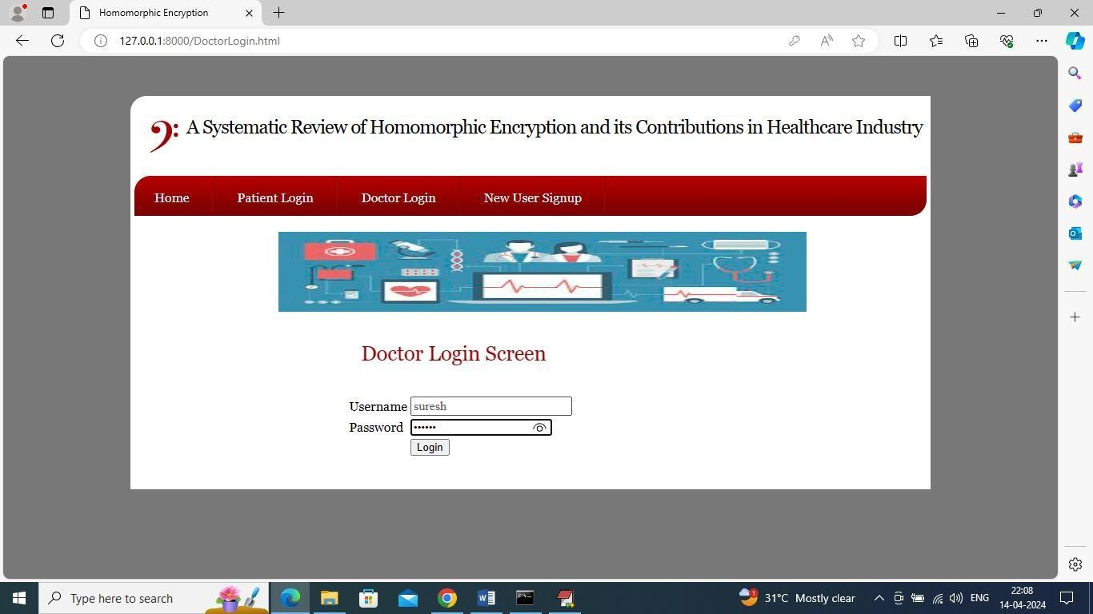
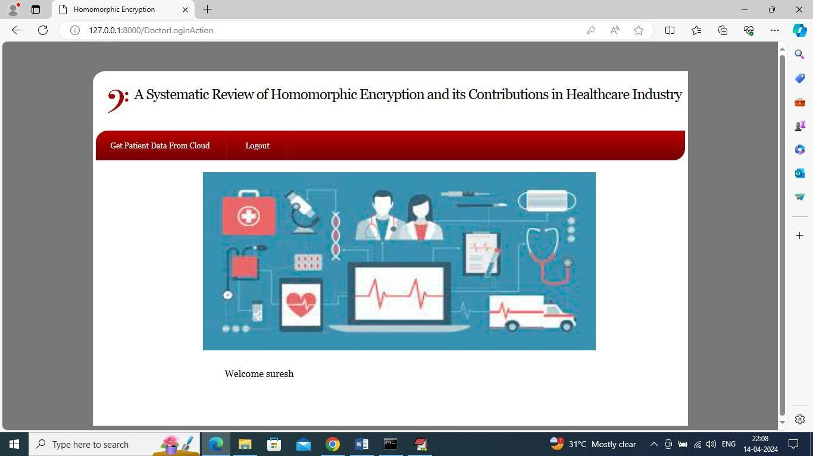
In above screen doctor can click on ‘Get Patient Data from Cloud’ link to query cloud to send al patient data and get below output
In above screen doctor is login and after login will get below page

Slide 33
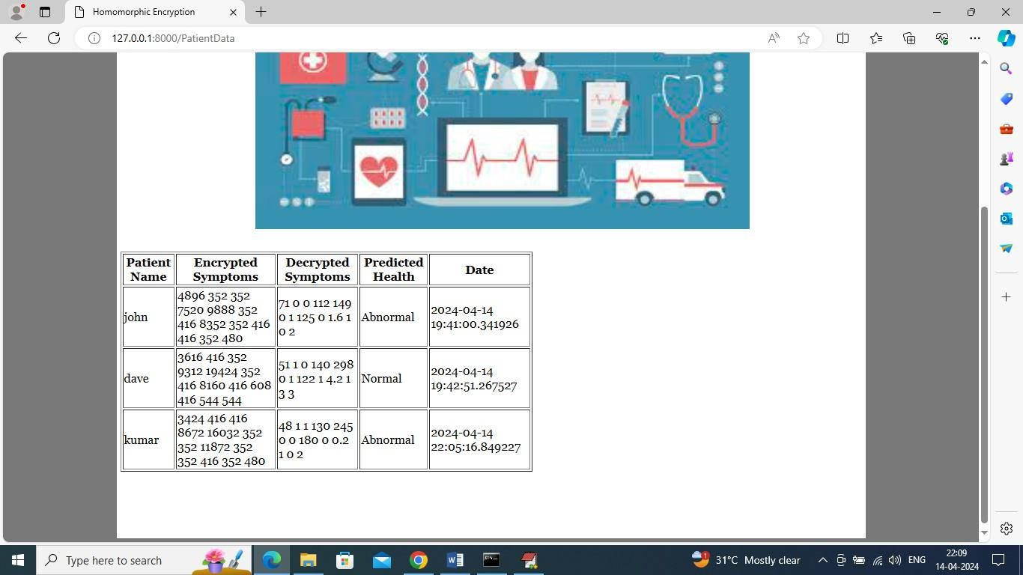
In above screen doctor can view all patient data in encrypted and decrypted details along with prediction as ‘Normal or Abnormal.

Slide 34
CONCLUSION & FUTURE ENHANCEMENTS
We applied our method of Homomorphic Encryption to calculate medical diagnostic functions based on encrypted medical data. Our Homomorphic Encryption scheme permits the use of machine learning algorithms that utilize polynomial kernel functions. These computations allow for medical diagnostics to be performed on encrypted data, maintaining the privacy of patient data. We outlined example scenarios where secure machine learning could be useful within the medical community, considering the protection of patient data as well as a researchers intellectual property.
Our method provides very efficient computation on encrypted data, which allows us to compute any polynomial function on a single patients encrypted data in a fraction of a second. A polynomial function can be computed on a medical encrypted database in a couple of minutes. Planned future work includes adapting the current encryption scheme to working with non-linear classifiers, such as Volterra systems.

Slide 35
BIBILOGRAPHY
Mbungu, N.T.; Bansal, R.C.; Naidoo, R.M.; Bettayeb, M.; Siti, M.W.; Bipath, M. A dynamic energy
management system using smart metering. Appl. Energy 2020, 280, 115990. [CrossRef]
Elsisi, M.; Mahmoud, K.; Lehtonen, M.; Darwish, M.M. Reliable industry 4.0 based on machine learning and IOT for analyzing, monitoring, and securing smart meters. Sensors 2021, 21, 487. [CrossRef] [PubMed]
Luciani, C.; Casellato, F.; Alvisi, S.; Franchini, M. Green smart technology for water (GST4Water): Water loss identification at user level by using smart metering systems. Water 2019, 11, 405. [CrossRef]
Loureiro, D.; Vieira, P.; Makropoulos, C.; Kossieris, P.; Ribeiro, R.; Barateiro, J.; Katsiri, E. Smart metering use cases to increase water and energy efficiency in water supply systems. Water Sci. Technol. Water Supply 2014, 14, 898–908. [CrossRef]
Chakraborty, S.; Das, S.; Sidhu, T.; Siva, A. Smart meters for enhancing protection and monitoring functions in emerging distribution systems. Int. J. Electr. Power Energy Syst. 2021, 127, 106626. [CrossRef]

Slide 36

THANK YOU
Dept. of CSE, SJCIT

